Slide 1
SDLC Methodologies
What is the SYSTEM DEVELOPMENT LIFE CYCLE?
The System Development Life Cycle or SDLC is a software project management model used to outline, design, develop, test, and deploy an information system or software product. In other words, it defines the necessary steps needed to take a project from the idea or concept stage to the actual deployment and further maintenance.
SDLC represents a multitude of complex models used in software development. On a practical level, SDLC is a general methodology that covers different step-by-step processes needed to create a high-quality software product.

Slide 2
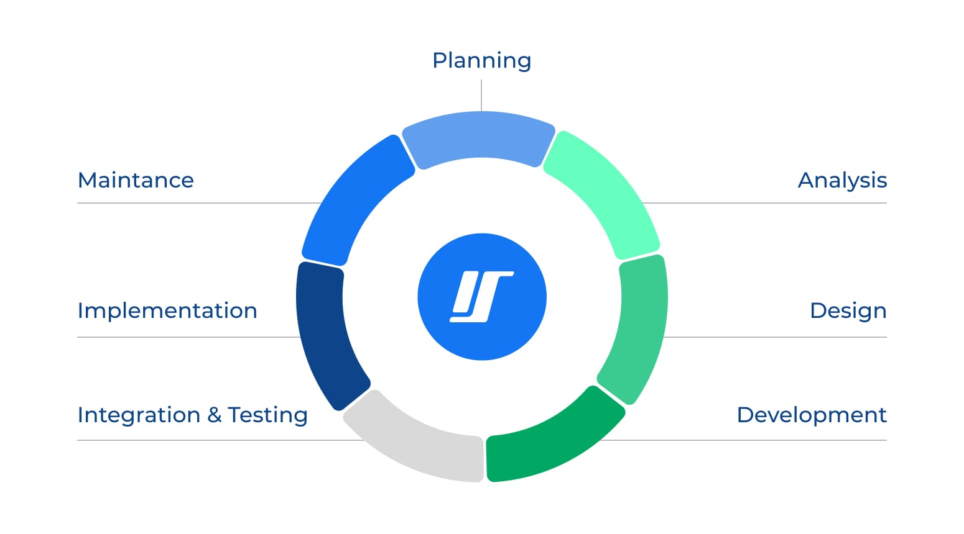
SDLC Steps

Slide 3
Let’s take a look at the core tasks associated with each of the different phases of the development life cycle.

Slide 4
1. Planning Stage – What Are the Existing Problems?
Planning is one of the core phases of SDLC. It acts as the foundation of the whole SDLC scheme and paves the way for the successful execution of upcoming steps and, ultimately, a successful project launch.
In this stage, the problem or pain the software targets is clearly defined.
First, developers and other team members outline objectives for the system and draw a rough plan of how the system will work.
Then, they may make use of predictive analysis and AI simulation tools at this stage to test the early-stage validity of an idea.
This analysis helps project managers build a picture of the long-term resources required to develop a solution, potential market uptake, and which obstacles might arise.
At its core, the planning process helps identify how a specific problem can be solved with a certain software solution.
Crucially, the planning stage involves analysis of the resources and costs needed to complete the project, as well as estimating the overall price of the software developed.
Finally, the planning process clearly defines the outline of system development. The project manager will set deadlines and time frames for each phase of the software development life cycle, ensuring the product is presented to the market in time.

Slide 5
2. Analysis Stage – What Do We Want?
Once the planning is done, it’s time to switch to the research and analysis stage.
In this step, you incorporate more specific data for your new system. This includes the first system prototype drafts, market research, and an evaluation of competitors.
To successfully complete the analysis and put together all the critical information for a certain project, developers should do the following:
Generate the system requirements. A Software Requirement Specification (SRS) document will be created at this stage. Your DevOps team should have a high degree of input in determining the functional and network requirements of the upcoming project.
Evaluate existing prototypes. Different prototypes should be evaluated to identify those with the greatest potential.
Conduct market research. Market research is essential to define the pains and needs of end-consumers. In recent years, automated NLP (natural language processing) research has been undertaken to glean insights from customer reviews and feedback at scale.
Set concrete goals. Goals are set and allocated to the stages of the system development life cycle. Often, these will correspond to the implementation of specific features.
Most of the information generated at this stage will be contained in the SRS. This document shapes the strict regulations for the project and specifies the exact software model you will eventually implement.

Slide 6
3. Design Stage – What Will the Finished Project Look Like?
The next stage of a system development project is design and prototyping.
This process is an essential precursor to development. It is often incorrectly equated with the actual development process but is rather an extensive prototyping stage.
This step of the system development life cycle can significantly eliminate the time needed to develop the software. It involves outlining the following:
The system interface; Databases, Core software features (including architecture like microservices)
User interface and usability;
Network and its requirement;
As a rule, these features help to finalize the SRS document as well as create the first prototype of the software to get the overall idea of how it should look like.
Prototyping tools, which now offer extensive automation and AI features, significantly streamline this stage. They are used for the fast creation of multiple early-stage working prototypes, which can then be evaluated. AI monitoring tools ensure that best practices are rigorously adhered to.

Slide 7
4. Development Stage – Let’s Create the System
In the development stage of SDLC, the system creation process produces a working solution. Developers write code and build the app according to the finalized requirements and specification documents.
This stage includes both front and back-end development. DevOps engineers are essential for allocating self-service resources to developers to streamline the process of testing and rollout, for which CI/CD is typically employed.
This phase of the system development life cycle is often split into different sub-stages, especially if a microservice or miniservice architecture, in which development is broken into separate modules, is chosen.
Developers will typically use multiple tools, programming environments, and languages (C++, PHP, Python, and others), all of which will comply with the project specifications and requirements outlined in the SRS document.

Slide 8
5. Testing Stage – Is It the Exact One We Needed?
The testing stage ensures the application’s features work correctly and coherently and fulfill user objectives and expectations.
This process involves detecting the possible bugs, defects, and errors, searching for vulnerabilities, etc., and can sometimes take up even more time compared to the app-building stage.
There are various approaches to testing, and you will likely adopt a mix of methods during this phase. Behavior-driven development, which uses testing outcomes based on plain language to include non-developers in the process, has become increasingly popular.
Similarly, automated and cloud-based platforms, which simulate testing environments, take a significant amount of manual time out of this stage of the system development life cycle. Selenium, a browser testing tool, is one popular example of such a platform.

Slide 9
6. Integration and Implementation Stage – How Will We Use It?
.
Once the product is ready to go, it’s time to make it available to its end users and deploy it to the production environment.
At this stage, the software undergoes final testing through the training or pre-production environment, after which it’s ready for presentation on the market.
It is important that you have contingencies in place when the product is first released to market should any unforeseen issues arise. Consider the different deployment methods and select the most appropriate for each case.
Microservices architecture, for example, makes it easy to toggle features on and off. And you will likely have multiple rollback protocols. A canary release (to a limited number of users) may be utilized if necessary.

Slide 10
7. Maintenance Stage – Let’s Make the Improvements
The last but not least important stage of the SDLC process is the maintenance stage, where the software is already being used by end-users.
During the first couple of months, developers might face problems that weren’t detected during initial testing, so they should immediately react to the reported issues and implement the changes needed for the software’s stable and convenient usage.
This is particularly important for large systems, which usually are more difficult to test in the debugging stage.
Automated monitoring tools, which continuously evaluate performance and uptime and detect errors, can assist developers with ongoing quality assurance. This is also known as “instrumentation.”

Slide 11
Benefits of SDLC
Having covered the major SDLC methodologies offered by software development companies, let’s now review whether they are actually worth employing.
Here are the benefits that the system development life cycle provides:
Comprehensive overview of system specifications, resources, timeline, and the project goals
Clear guidelines for developers
Each stage of the development process is tested and monitored
Control over large and complex projects
Detailed software testing
Process flexibility
Lower costs and strict time frames for product delivery
Enhanced teamwork, collaboration, and shared understanding

Slide 12
Possible Drawbacks of SDLC
Just like any other software development approach, each SDLC model has its drawbacks:
Increased time and costs for the project development if a complex model is required
All details need to be specified in advance
SDLC models can be restrictive
A high volume of documentation which can slow down projects
Requires many different specialists
Client involvement is usually high
Testing might be too complicated for certain development teams

Slide 13
Basic 6 SDLC Methodologies
Now that you know the basic SDLC phases and why each of them is important, it’s time to dive into the core methodologies of the system development life cycle.
These are the approaches that can help you to deliver a specific software model with unique characteristics and features. Most developers and project managers opt for one of these 6 approaches. Hybrid models are also popular.
Let’s discuss the major differences and similarities of each.

Slide 14
Read on the SDLC Methodologies
Waterfall Model
Iterative Model
Spiral Model
V-Model
The Big Bang Model
Agile Model

Slide 15
Revision Questions
1. Your university wants to digitize the student clearance and graduation process, but requirements are not yet fully understood.
  Which SDLC model would you recommend?
  Justify your answer with at least three reasons.
2. A national hospital is developing a critical patient-records system where accuracy and testing are essential.
  Which SDLC model best fits this context?
  Explain how it ensures safety and reliability.
3. A software startup is building a new mobile-payment application and needs to release improvements rapidly.
  Which SDLC approach should be adopted?
  Describe how the approach supports continuous enhancement.
4. A government agency plans a complex system involving multiple vendor integrations and high uncertainty in requirements.
  Explain why the Spiral model or a Hybrid Agile–Waterfall model might be ideal.

